Slide 1

Algo in Computational Biology Hackathon
(Co. #76558)
Amit Halbreich, Noam Delbari, Omer Mushlion,
David Zuravin, Yaniv Pasternak, Elisheva Morgensteren
Identifying TADs using Gaussian
HMM Model training and
exploring characteristics of
intra and inter domains

Slide 2

Background
DNA's 3D structure influences its function, with spatial organization facilitating interactions between distant genomic regions.
- Topological association domains (TADs) are regions where such interactions occur more frequently. - Strong self-interaction. -Base unit of chromosome folding:
~$1MB$
- Topological association domains (TADs) are regions where such interactions occur more frequently. - Strong self-interaction. -Base unit of chromosome folding:
~1𝑀𝐵

Slide 3

Research Question
Can boundaries between TADs can be predicted using an HMM and how interaction within TAD connected to the function of regulatory elements?

Slide 4
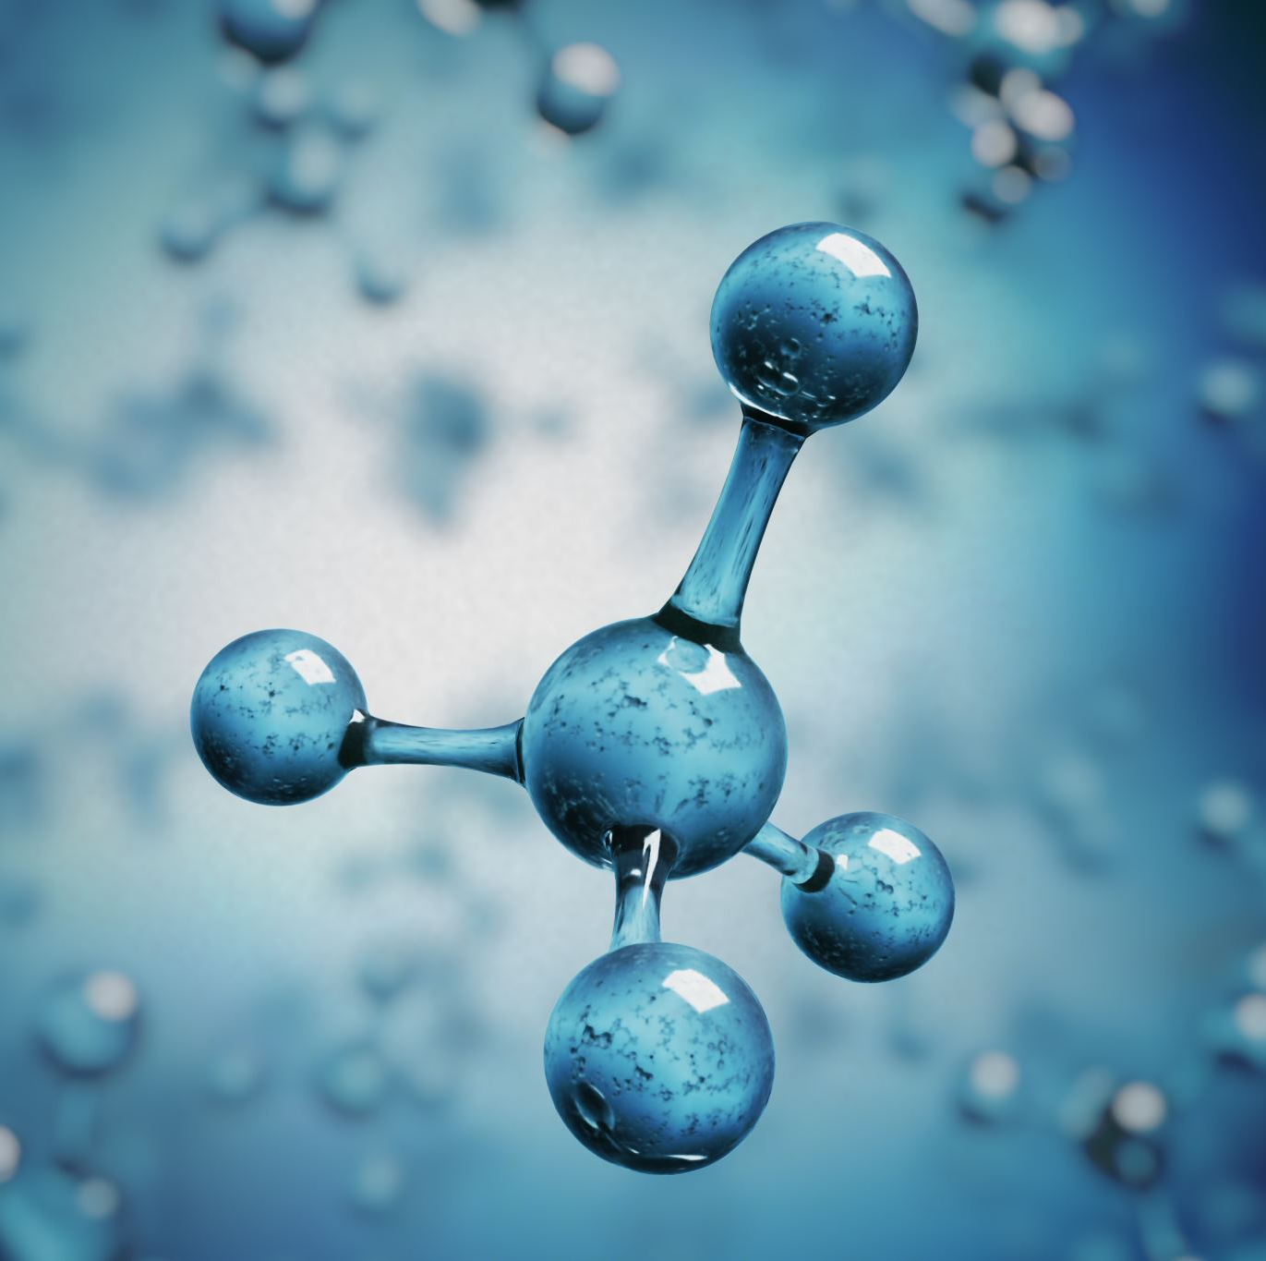
Hypothesis
Our hypothesis is that TADs can be accurately predicted by Gaussian HMM Model and there are unique interactions in the boundaries, which might indicate on specific gene expressions.
Moreover, we think that there might be unique interactions for specific cells in TADs.

Slide 5
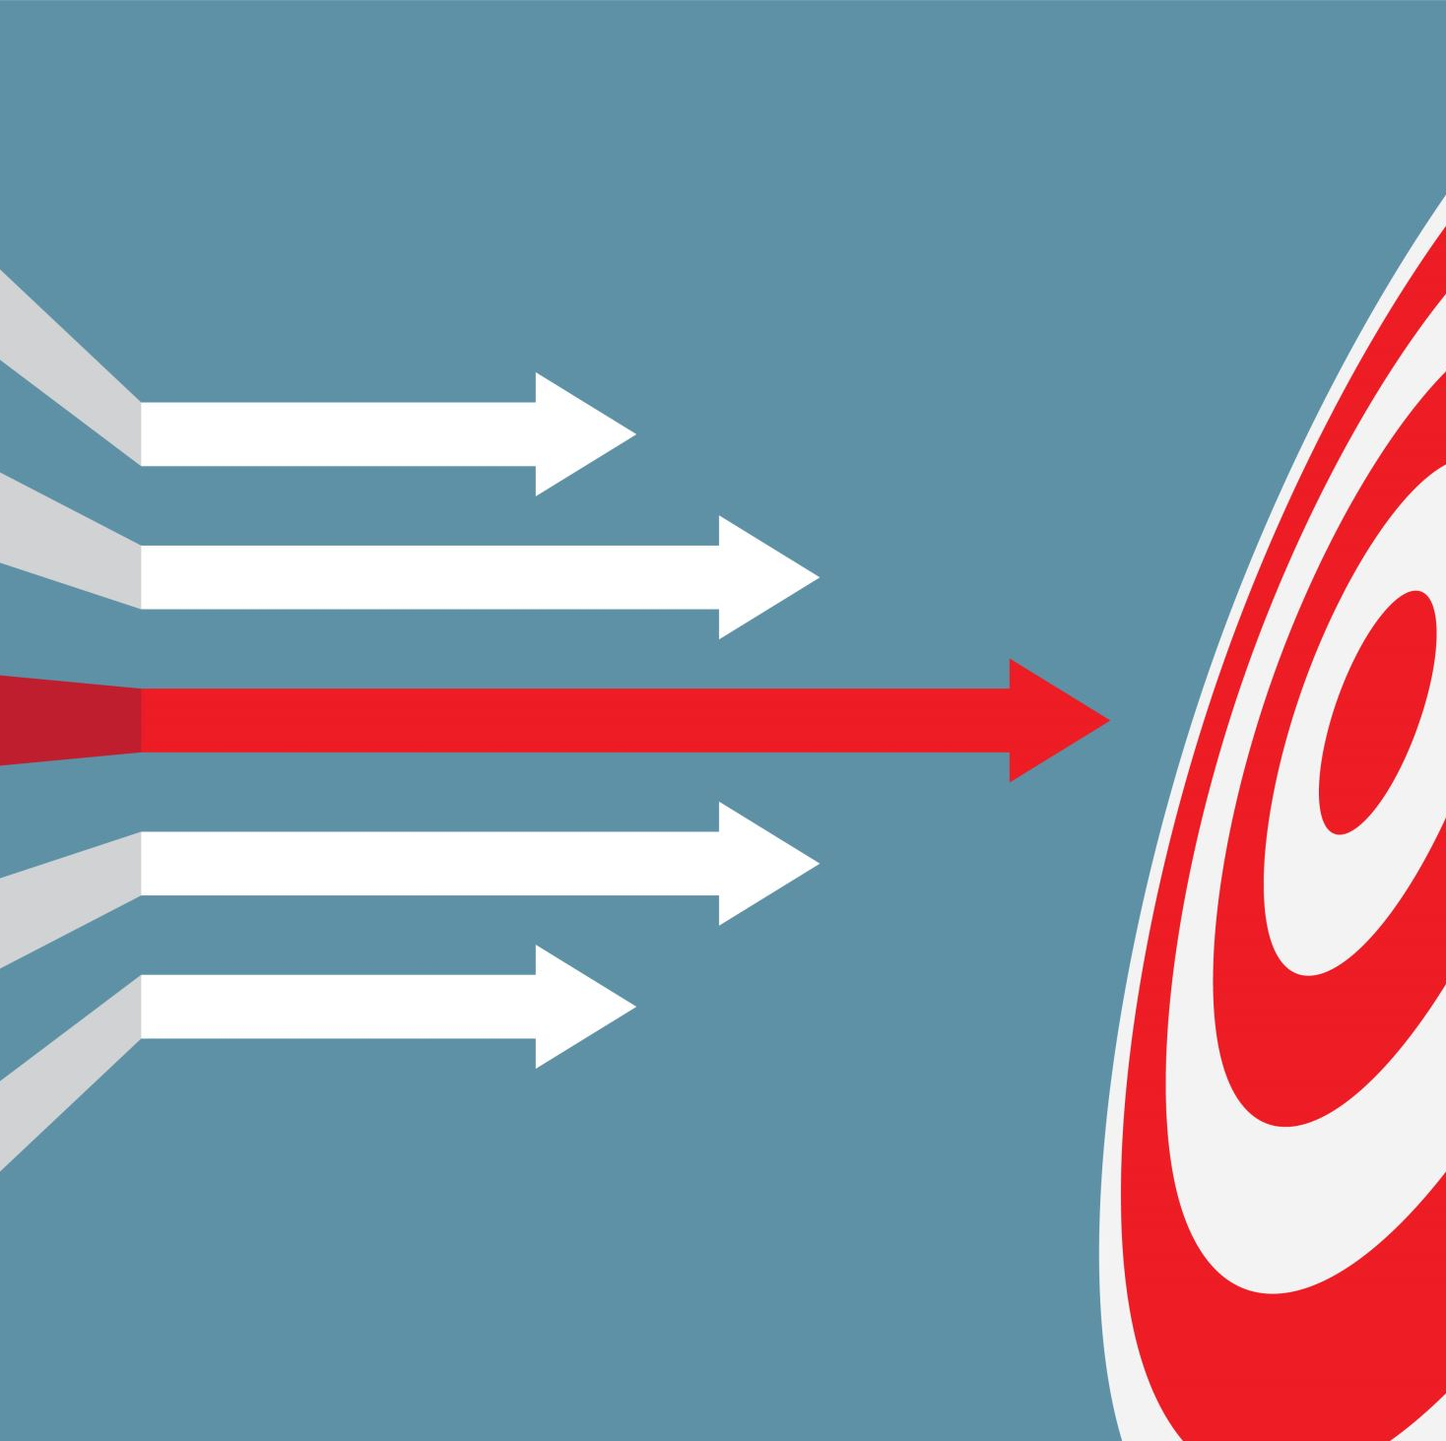
Goals
Predict accurately TADs and their boundaries.
Find out how conserved the TADs between different cells.
Characterize unique interactions in TADs for different cells.
Investigate interactions in subdomains in TADs.

Slide 6
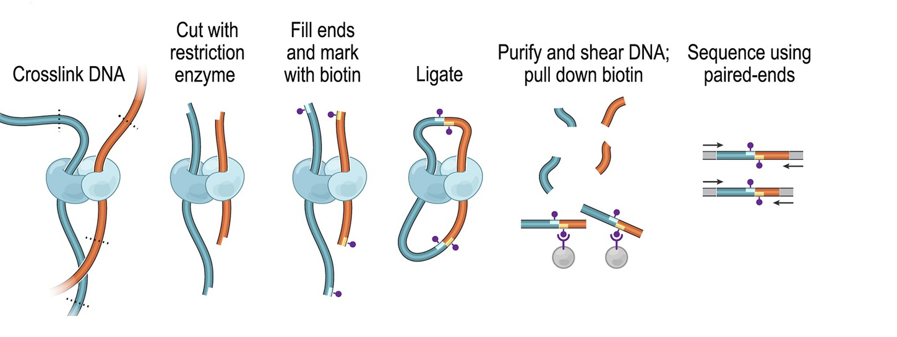
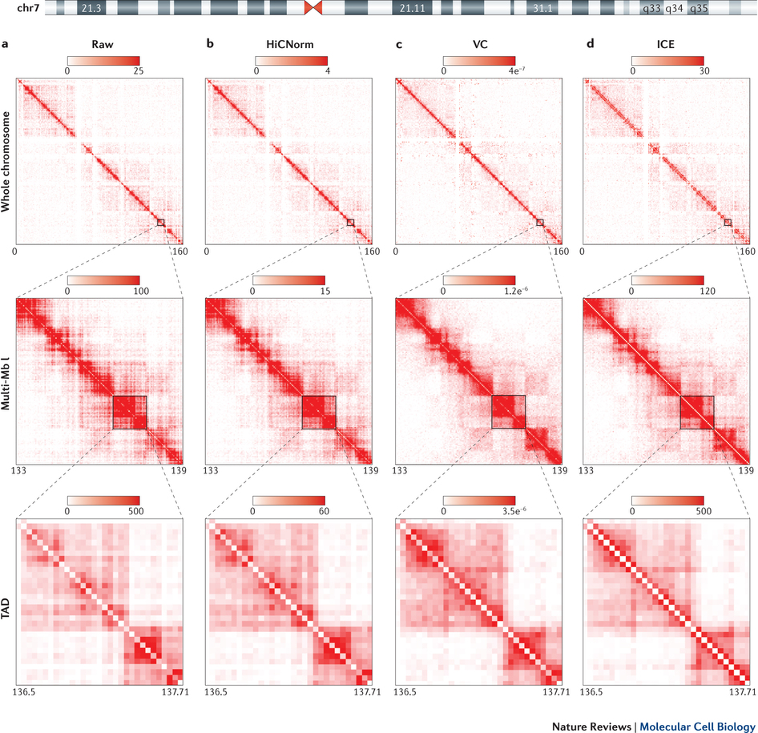

Data
The data we’ve used is Hi-C datasets from 21 cells in primary human tissues:
Hi-C Data – Presented Results are from
Cortex, Liver & Hippocampus Cells CHR2
• Count chromatin interaction
• Repeated million of time
• Hi-C $Heatmap(i,j)$= #interactions
between blocks $i$ and $j$
• #interactions decrease as the distance from the diagonal increase.
Schmitt, Anthony D., Ming Hu, and Bing Ren. "Genome-wide mapping and analysis of chromosome architecture." Nature Reviews Molecular Cell Biology(2016).‏

Slide 7
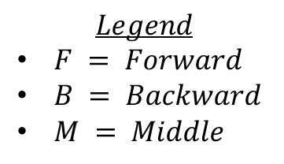

Model Architecture
Score definition:
$“DI Left−Right”$ Score: $\frac{L−R}{|L−R|}\left(\frac{{\left(L−E\right)}^{2}}{E}+\frac{{\left(R−E\right)}^{2}}{E} \right)$
$L$ is the sum of interaction from left and $R$ is the sum of interaction from right (in $2MB$ window):
$$E = \frac{L+R}{2}$$
$DI>0$bias Upstream , $DI<0$ bias Downstream
Modeling by Gaussian HMM Model
Define Transition Matrix by Constraint:
F
M
B
$$Legend$$
$F = Forward$
$B = Backward$
$M = Middle$

Slide 8
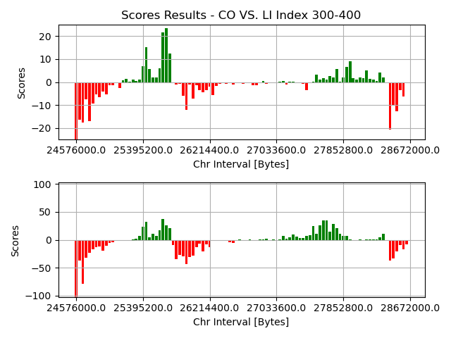
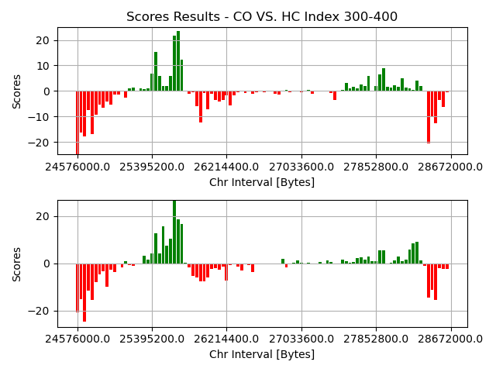
Cells Score Comparison
Cortex (Up) VS Liver (Down) – CHR2
Cortex (Up) VS Hippocampus (Down) – CHR2
TADs are usually preserved even if the DNA is of cell that comes from a different region in the body (Liver VS Cortex).
Score values may vary between different cells but overall, the TADs are very alike when observing different cells.

Slide 9
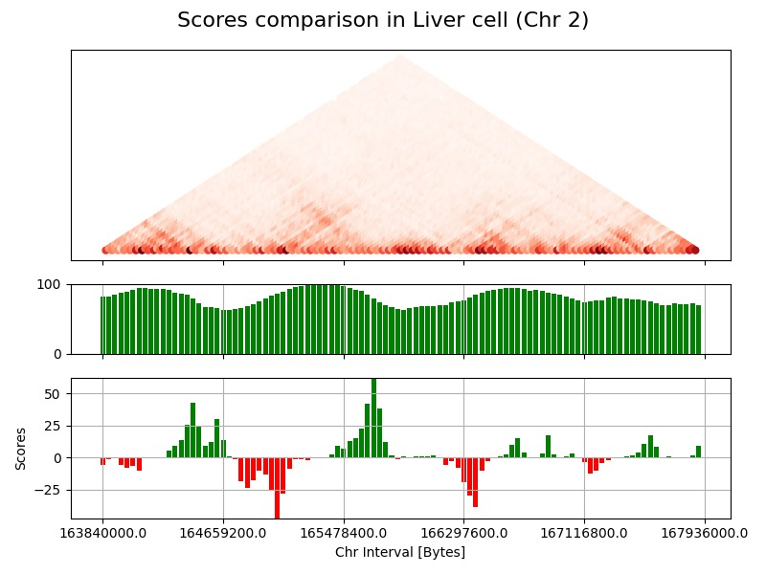
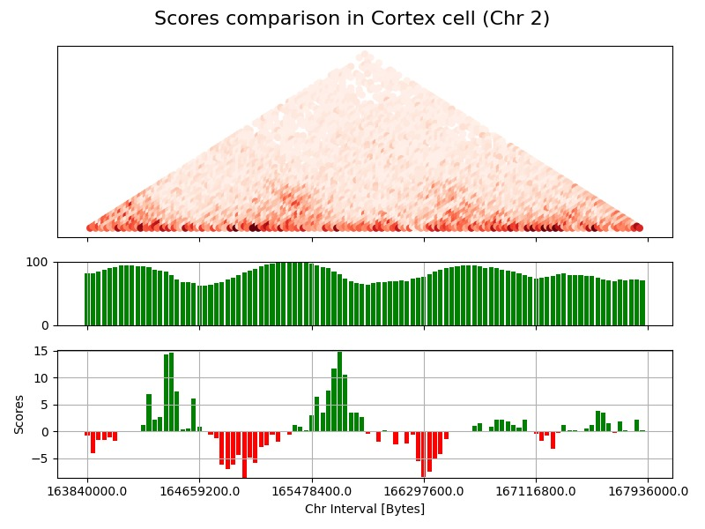
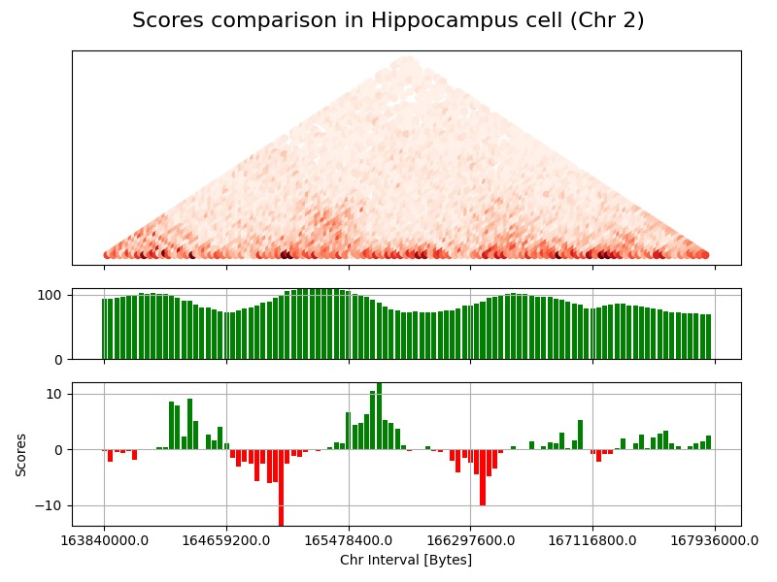
DI VS Insulation Score Comparison
CHR2 Liver Cell
CHR2 Cortex Cell
CHR2 Hippocampus Cell

Slide 10
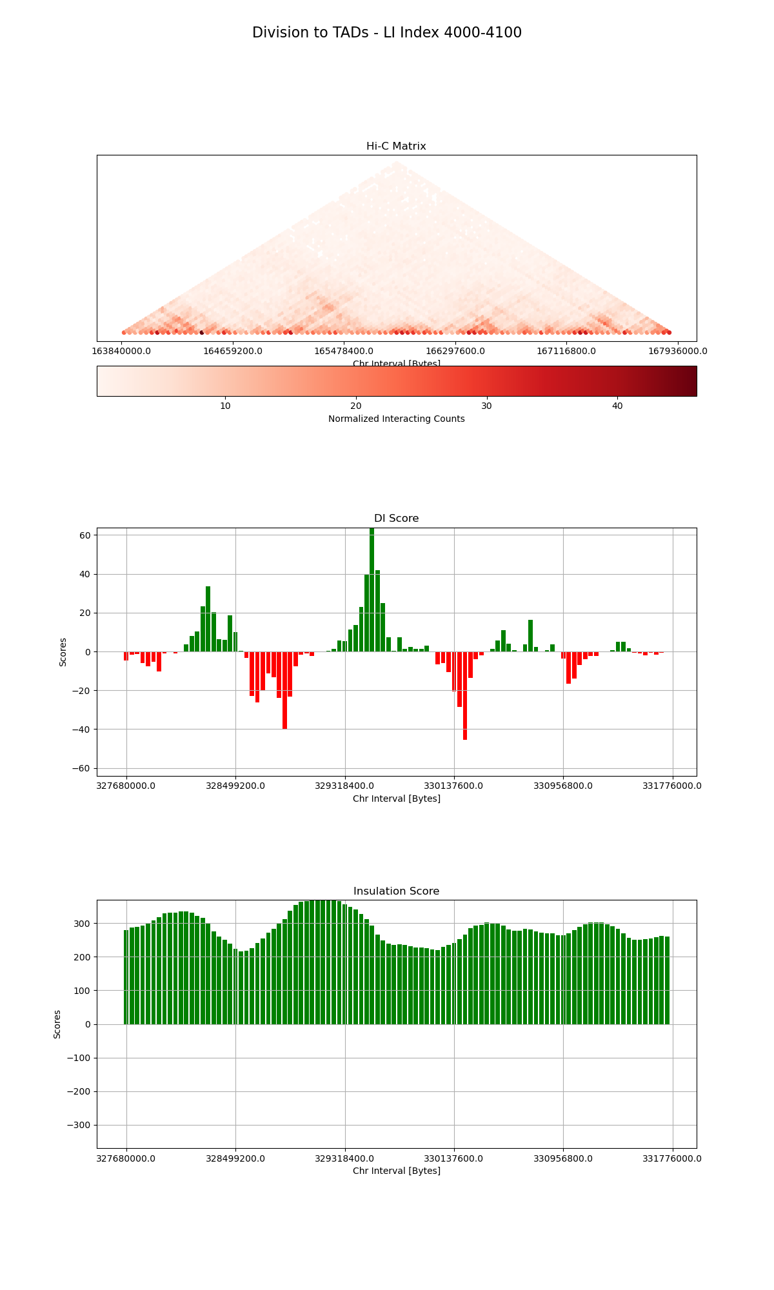
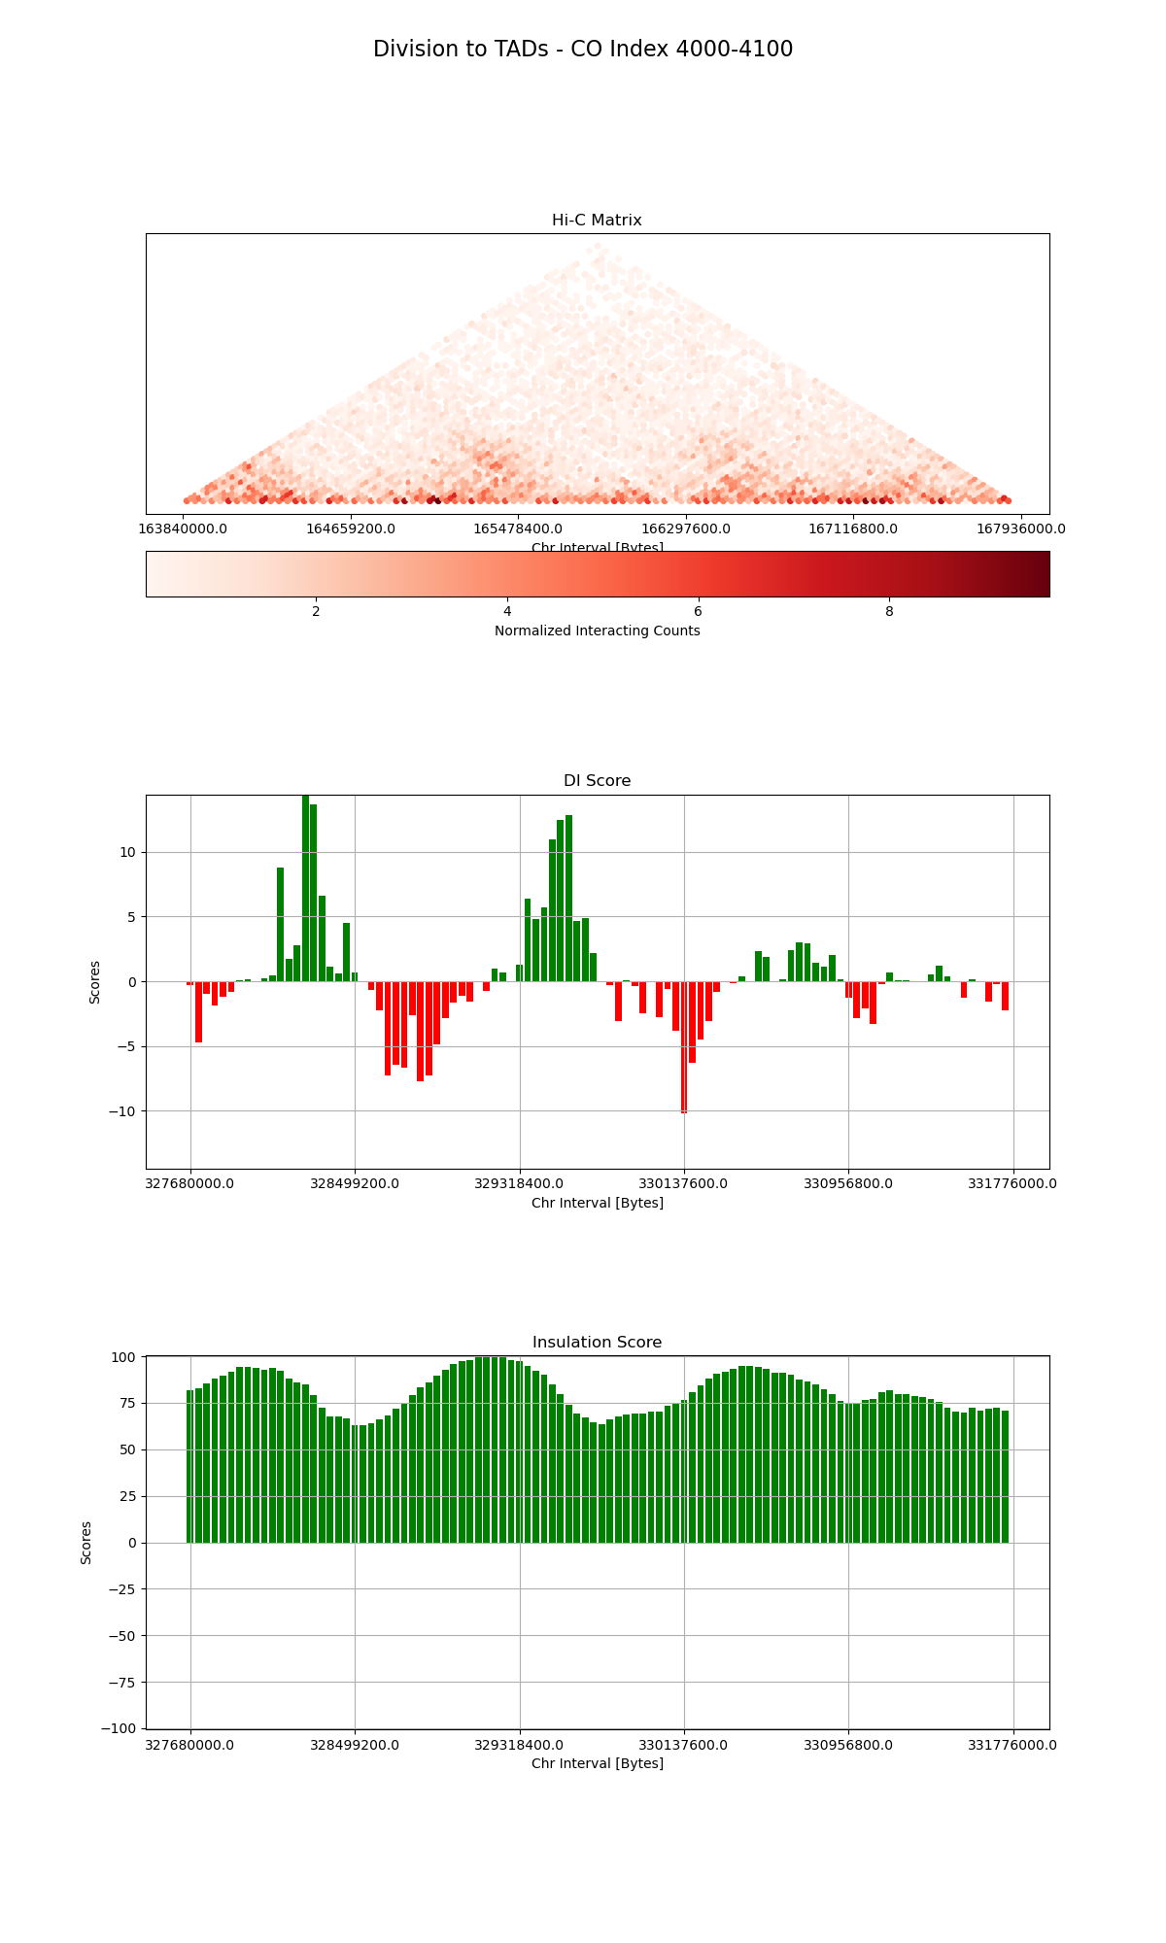
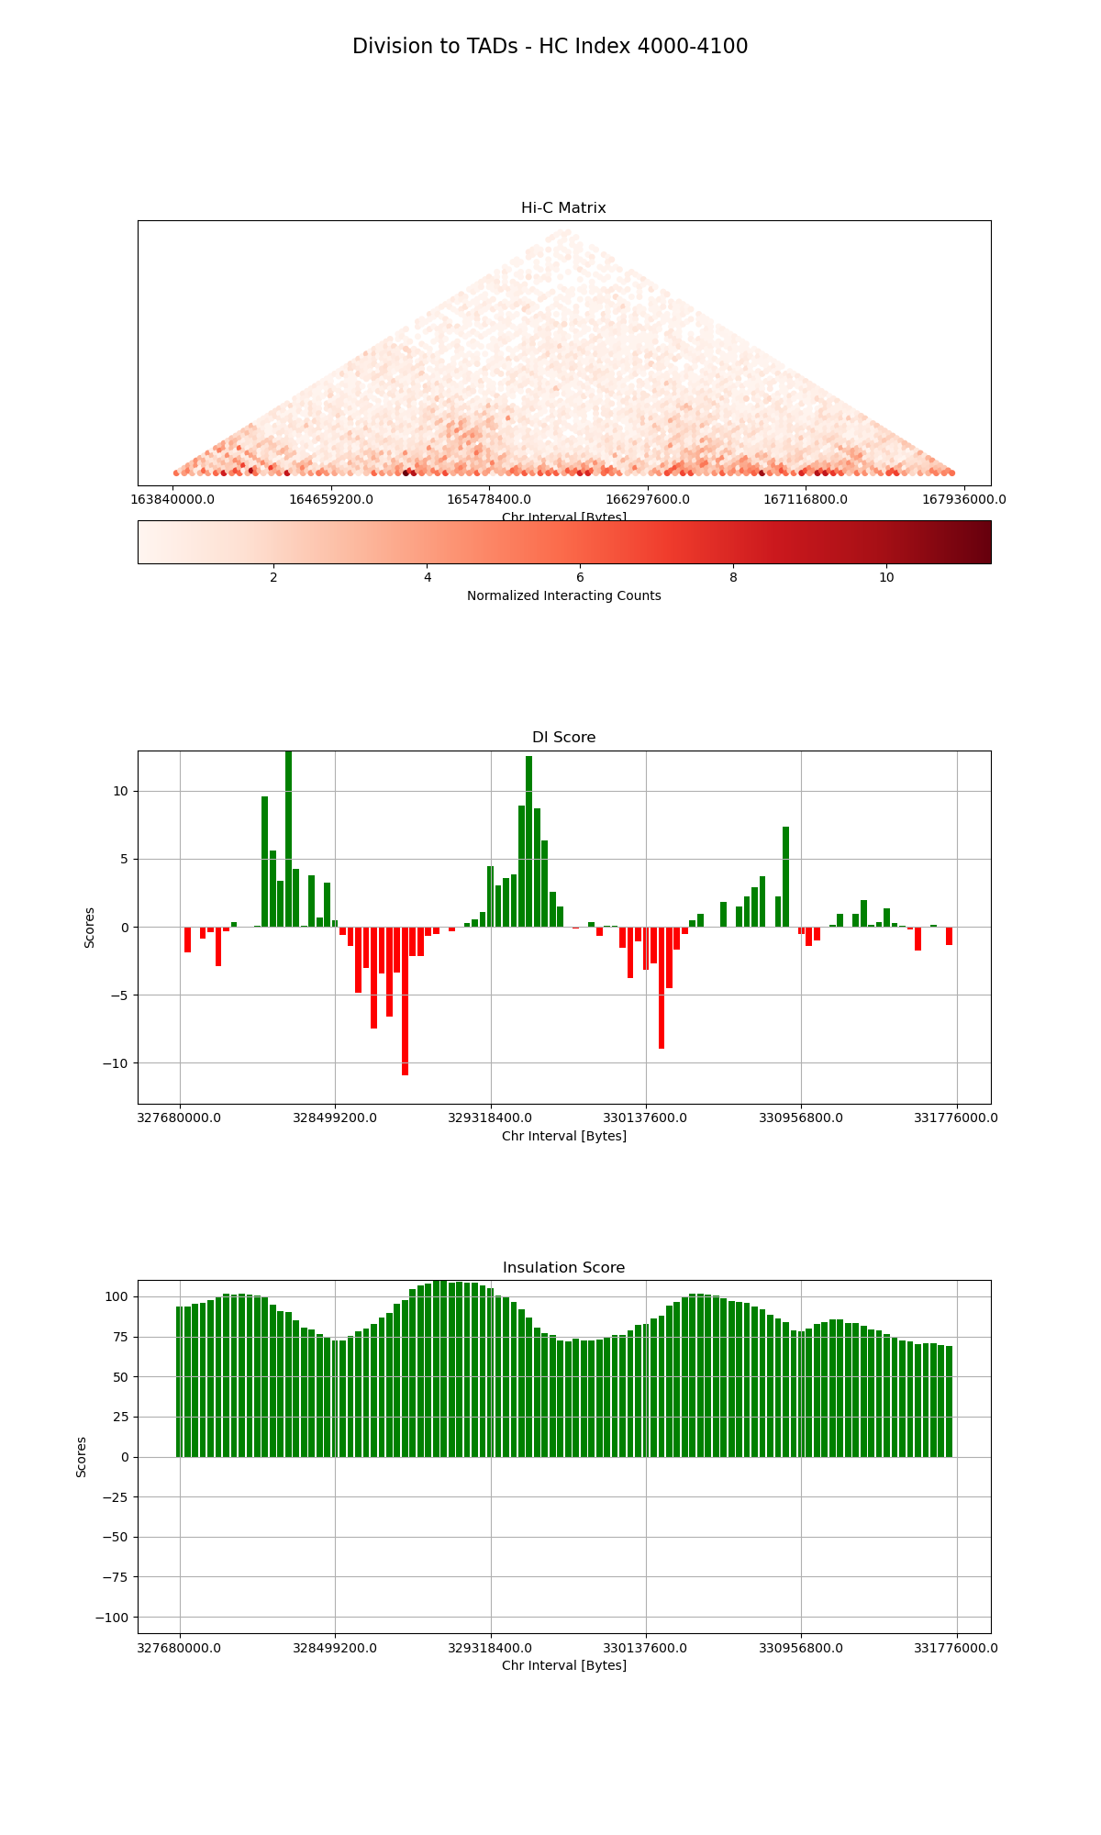
Min. Insulation Points = Possible TADs
CHR2 Liver Cell
CHR2 Cortex Cell
CHR2 Hippocampus Cell

Slide 11

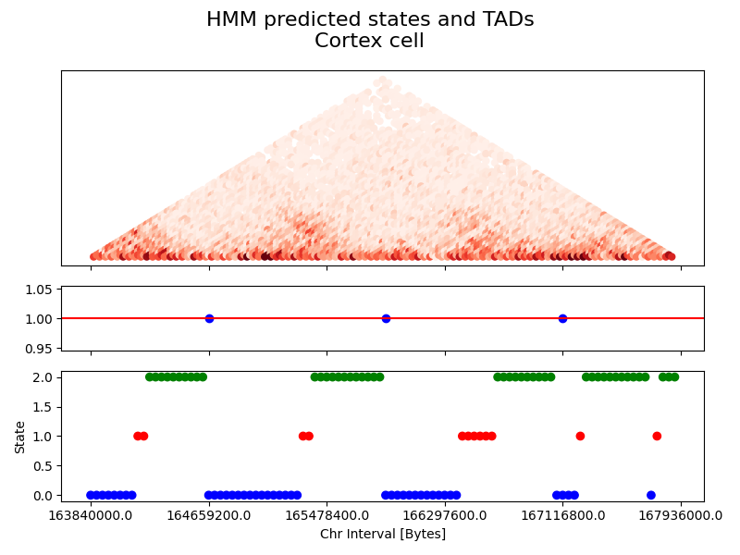
HMM Result

Slide 12
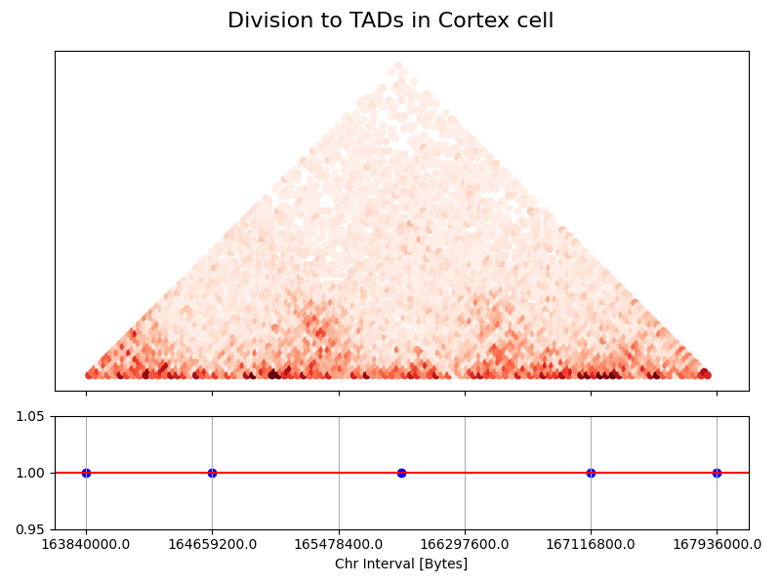
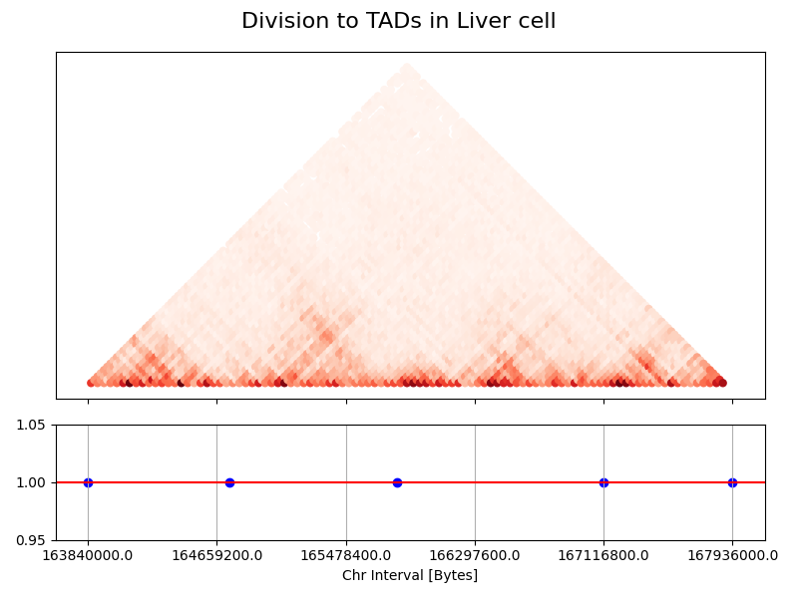
Predicted Domains Conservation

Slide 13
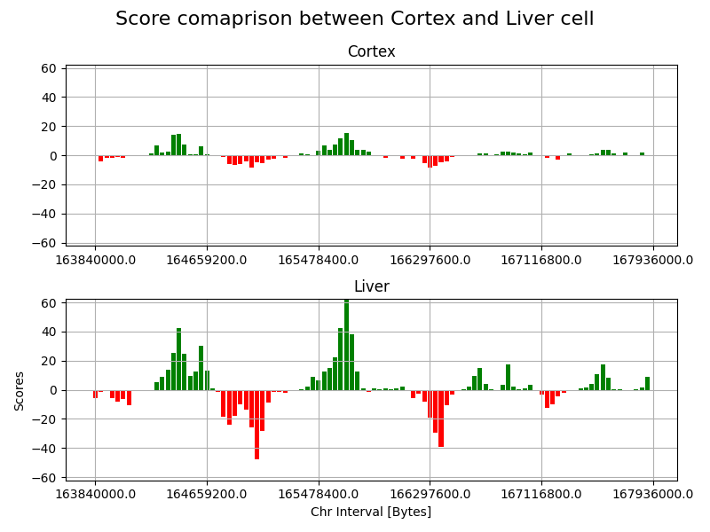
Interaction Variations
Between Cells
Diffrerent cells exhibit different characterstic of interaction in TADs.
In this section, liver cell has much stronger activity compared to the Cortex.
It might be that this section is more related to regulating liver cell.

Slide 14
A-B Compartment
Hi-C data is very complex, and its interpretation is not trivial.
One strategy is to look for general patterns in an unbiased way with Principal Component Analysis (PCA).
Using PCA we can divide the two groups A and B,
Active groups and inactive groups.
To perform PCA on Hi-C data, we apply it to the distance-normalized interaction matrix.
Usually, the values for the first principal component (PC1) are the most informative.

Slide 15
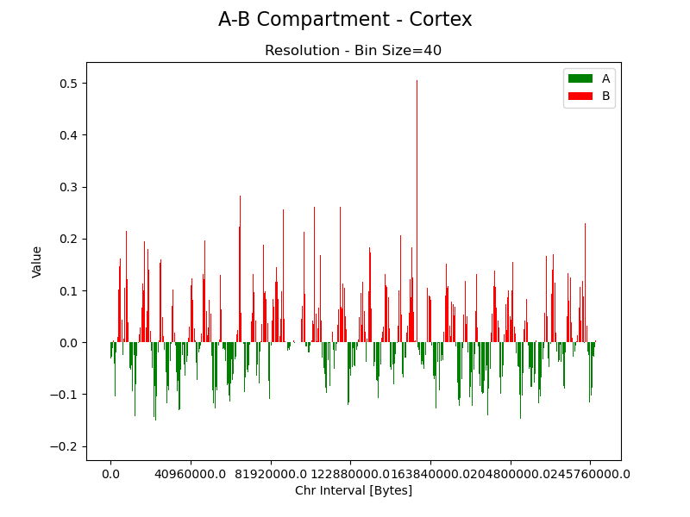
A-B Compartment
The division into groups is by taking one group that is above the y-axis and a second group is everything below the y-axis.

Slide 16
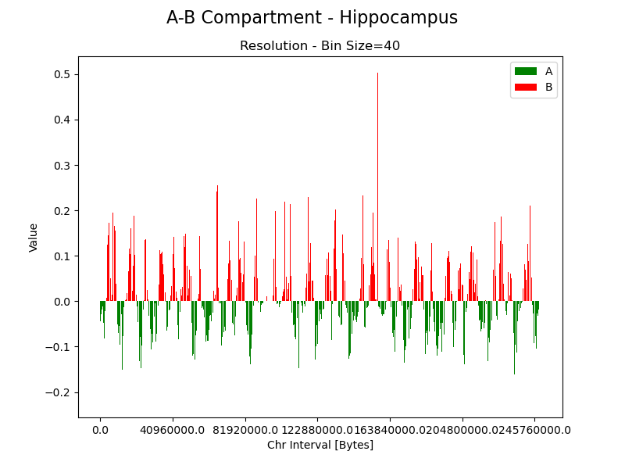
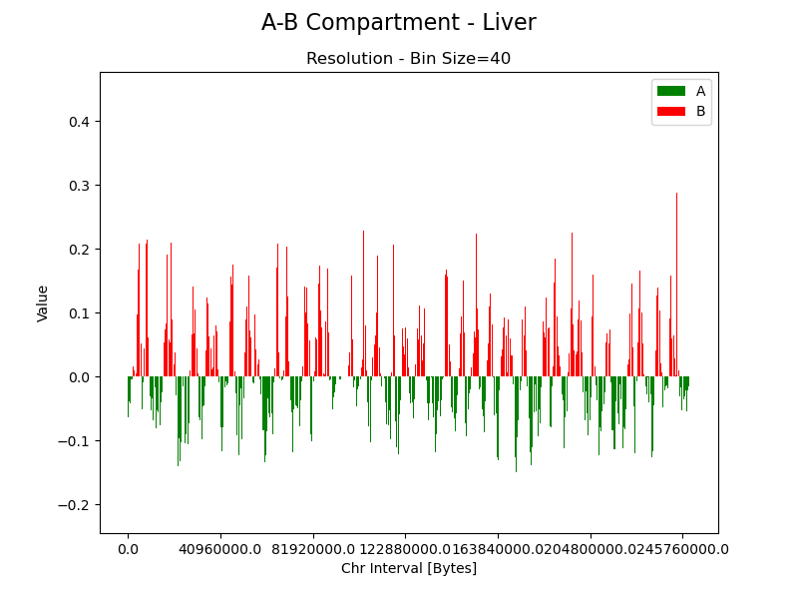
A-B Compartment Comparison
A-B Compartments for different cells from same CHR2 are very alike:
It is a good generalization of the TADs to 2 groups division – reminds of DI score.

Slide 17

Related Articles
Leading Article we used for Score Calculation and HMM Modeling on different cells:
Topological domains in mammalian genomes identified by analysis of chromatin interactions
https://www.nature.com/articles/nature11082
For Insulation Score calculation:
Chromosome compartments on the inactive X guide TAD formation independently of transcription during X-reactivation
https://www.nature.com/articles/s41467-021-23610-1#Abs1
For PCA on Genome:
Comprehensive mapping of long-range interactions reveals folding principles of the human genome
https://www.ncbi.nlm.nih.gov/pmc/articles/PMC2858594/

